Slide 1
TESTING SERVICE LINE
Test Automation Training Factory

Slide 2

Contents
Introduction to Selenium WebDriver
Benefits & Limitations
Comparison with other tools
Introduction to Java
Java Misc
Locators

Slide 3
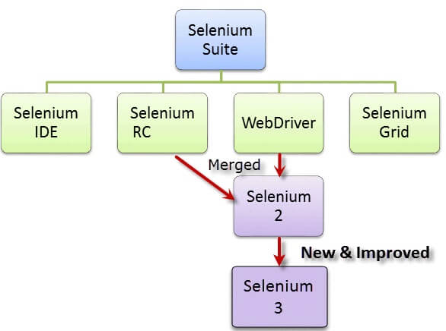
Selenium
Selenium is not just a single tool but a suite of software's, each catering to different testing needs of an organization.
Selenium IDE - Plugin to Firefox to record and play test in Firefox and also export tests in different languages
Selenium RC - Allows playing of exported test in different platform/OS
Selenium Web driver 2.0 - Driving a browser natively as a user would either locally or on a remote machine using the Selenium Server it marks a leap forward in terms of browser automation

Slide 4
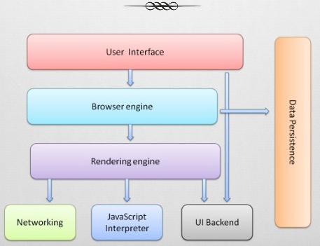
How browser works?

Slide 5
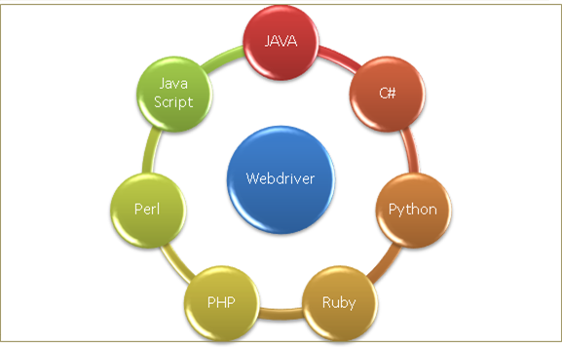
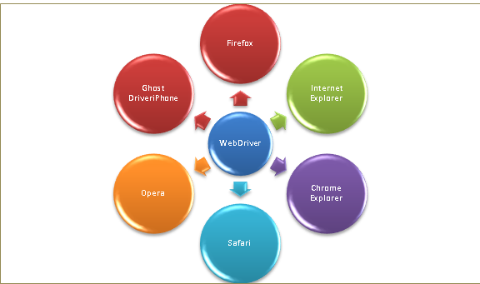
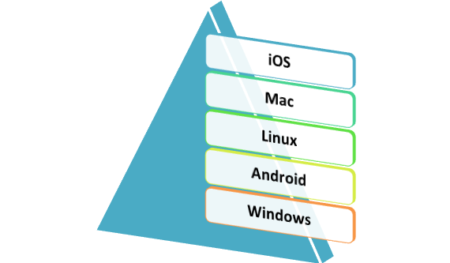
Selenium WebDriver
Multiple Languages Binding SUPPORT
Multiple Browser Support
Multiple Platform Support
Selenium Web Driver is the successor to Selenium RC. Selenium Web Driver accepts commands via a Client API and sends them to a browser through a browser-specific driver and retrieves results.
Classification: Birlasoft Internal
Classification: Birlasoft Internal

Slide 6
Benefits & Limitations of Selenium Suite
Benefits:
Open source & Free
Supports multiple operating systems (Windows / Linux / MAC / Android / iOS etc..)
Supports most of the browser, thus allows cross browser & environment testing
Easy installation & infrastructure
Parallelism (Parallel & Distributed execution)
Variety of frameworks exists & Huge open source community support is available
Integration with 3rd party tools is possible
Limitations:
Only supports Web based applications
It is difficult to test Image based application
Need little technical expertise on underlying language such as Java / C# / Python / Perl / Ruby / Jscript

Slide 7
Comparison with other Functional Tools
Category | Selenium | QTP | Coded UI
Record & playback
Ease of IDE & Features with Tool
Ease of Execution
Language Support | Java, C#, Perl, Python, Ruby, Jscript | VBScript | C# & VB.Net
Browser Support | Almost all | IE, Firefox & Chrome | IE & Limited support for other browsers
Application Type | Only Web & Mobile | Web, Windows & Mobile | Web, Windows & Mobile
Easy To Use | Medium | Easy | Medium
Integration with 3rd Party Tools | Supported via exposed API’s | In-built support for HP ALM, Other integration possible via API | In-built support for various 3rd party tools, Other integration possible via API’s
Complete Support
Feature available but not at par

Slide 8
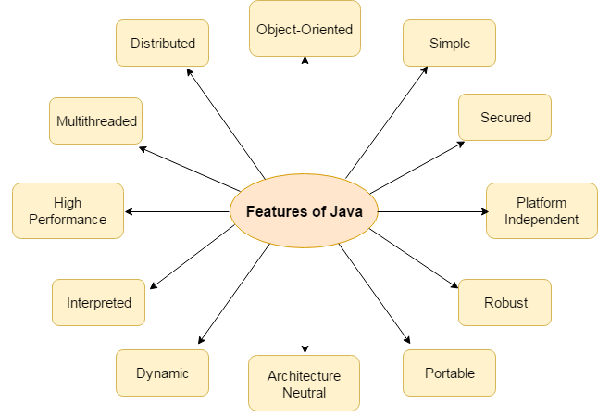
Introduction to Java
Java is a programming language and a platform.
Java is a high level, robust, secured and object-oriented programming language
Any hardware or software environment, in which a program runs is known as a platform. Since Java has its own virtual runtime environment (JRE) and API, it is also a platform (JVM).

Slide 9
Java Naming Convention
Java naming convention is a rule to follow as you decide what to name your identifiers such as class, package, variable, constant, method etc. It is not forced to follow, so it is known as convention not rule.
All the classes, interfaces, packages, methods and fields of java programming language are given according to java naming convention.
Java follows camel case syntax for naming the class, interface, method and variable.
If name is combined with two words, second word will start with uppercase letter always e.g. actionPerformed(), firstName, ActionEvent, ActionListener etc.
Identifiers
A name in java program is called identifiers which can be used for identification purpose. It can be method name , class name , variable name or label name.
Allowed characters in java identifiers are ( a –z ,A-Z, 0-9,$ and _ ).
It shouldn’t start with digits.
Java keywords shouldn’t be used as Identifiers.
Identifiers in java are case sensitive i.e. foo and Foo are two different identifiers
All predefined java class names and interface names can be used as identifiers but it is not a good programing practice because it reduces readability and creates ambiguity.

Slide 10
Data Types
Data type is a special keyword used to allocate sufficient memory space for the data, in other words Data type is used for representing the data in main memory
Primitive
Non-Primitive
Type | Description | Default | Size | Example Literals
boolean | true or false | false | NA | true, false
byte | 2’s complement integer | 0 | 1 byte | (none)
char | Unicode character | \u0000 | 2 byte | ‘a’, ‘\u0041’, ‘\101’, ‘\\’, ‘\’’, ‘\n’
short | 2’s complement integer | 0 | 2 byte | 32, 4346, 32214
int | 2’s complement integer | 0 | 4 byte | 64623, 26263, -4412
long | 2’s complement integer | 0 | 8 byte | -2L, -1l, 4945885l
float | IEEE 754 floating point | 0.0f | 4 byte | 1.23e100f, 32.42f, -11.2332f
double | IEEE 754 floating point | 0.0 | 8 byte | 1.23456e300, 1e1, 233.65
Non-primitive data types are created by the programmer using primitive data types.
Types are:
Arrays
Classes
Collections
Maps

Slide 11
Array
Array is a collection of similar type of data. It is fixed in size means that you can't increase the size of array at run time. It is a collection of homogeneous data elements. It stores the value on the basis of the index value.
Advantages of Array:-
One variable can store multiple value: The main advantage of the array is we can represent multiple value under the same name.
Code Optimization: No, need to declare a lot of variable of same type data, We can retrieve and sort data easily.
Random access: We can retrieve any data from array with the help of the index value.
Disadvantages of Array:-
The main limitation of the array is Size Limit when once we declare array there is no chance to increase and decrease the size of an array according to our requirement, Hence memory point of view array concept is not recommended to use. To overcome this limitation in Java introduce the collection concept.

Slide 12
Selenium WebDriver Interface
WebDriver
(Interface)
RemoteDriver
FirefoxDriver
ChromeDriver
SafariDriver
WebDriver is an Interface, that is implemented by RemoteDriver and then extended by browser specific implementation classes.
WebDriver driver = new FirefoxDriver();
Defining a reference of WebDriver and instantiate it with desired browser specific class. By this way, we can generalize actions in script irrespective of browser type.

Slide 13
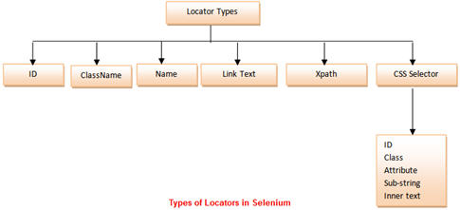
Locator Strategies

Slide 14
Locators
Understanding XPath
Xpath = //tagname[@attribute=“value”]
// : Select current node
Tagname : Tagname of the particular node @: Select attribute
Attribute: Attribute name of the node Value: Value of the attribute.
css-path
css=input[id=email]
DOM : Document Object Model: document.getEBTN('E')[0]
Element Locators
ID : id=foo
Name : name=foo
First ID, then name
DOM : document.forms[‘myform’].myDropdown
Xpath : xpath = //table[@id='table1']//tr[4]/td[2]
Link Text : link = sometext
CSS Selector : css = a[href=“#id3”]
Sensible defaults, e.g. xpath if starts with //

Slide 15
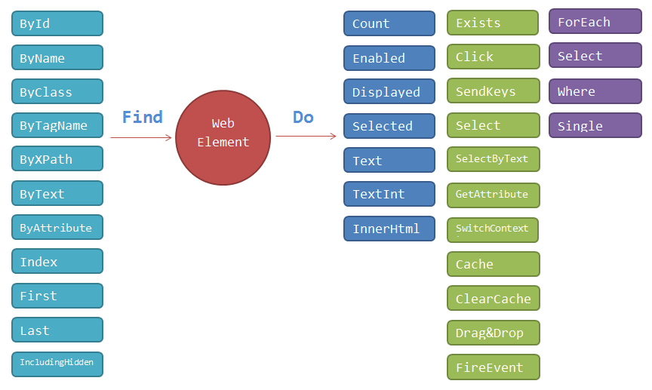
WebElement
All UI objects are represented by an object of class called WebElement.
Classification: Birlasoft Internal

Slide 16
Drivers for Firefox, IE, chrome
Launching Firefox Browser
Download geckodriver.exe from GeckoDriver Github Release Page. Make sure to download the right driver file based on your platform and OS version. Set the System Property for "webdriver.gecko.driver" with the geckodriver.exe path - System.setProperty("webdriver.gecko.driver","geckodriver.exe path").
Launching Chrome Browser
Download the latest ChromeDriver binary from Chromium.org download page and place the executable on your local machine. Set the webdriver.chrome.driver property to the chromeDriver.exe's location as- System.setProperty("webdriver.chrome.driver", "chromeDriver.exe path")
Launching Internet Explorer Browser
Like ChromeDriver, InternetExplore driver also requires setting up the "webdriver.ie.driver" property with the location of IEDriverServer.exe.

Slide 17
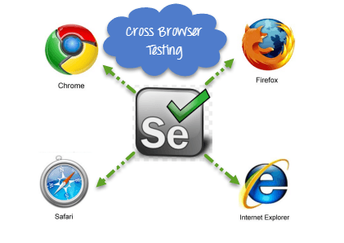
Cross Browser Testing
What is Cross Browser Testing?
Cross Browser Testing is a type of functional test to check that your web application works as expected in different browsers.
How to perform Cross Browser Testing
To execute test cases with different browsers in the same machine at the same time we can integrate TestNG framework with Selenium WebDriver
Reasons for Cross Browser Testing
Font size mismatch in different browsers
JavaScript implementation can be different
CSS, HTML validation difference can be there
Some browser still not supporting HTML5
Page alignment and div size
Image orientation
Browser incompatibility with OS

Slide 18
Dynamic Waits & Synchronization
When we perform a set of action on a web page, many processes are invoked in the back-end systems. So, the response time of the application might not be the same every time. Let us assume the web server or the application server or the database server is slow a bit and because of that the response time is increased by a few seconds. Because of the delay in response time, the Selenium will not be able to find the required elements on time, and it will result in failure of the test script. So, we need to inculcate a mechanism in our automation script that deals with such type of delays, this is nothing but Synchronization between our tool and the application under test.
Synchronization/ Waits can be achieved in many different ways :
Sleep method of Thread class
Implicit Wait & Timeout Interface (Page Load and Script Timeout)
Explicit Wait – WebDriverWait and FluentWait
Capturing Screenshot
Capturing screenshots with WebDriver
For taking screenshots, Selenium has provided TakesScreenShot interface, wherein getScreenshotAs method is implemented in child classes to take screenshot:
File scrFile = ((TakesScreenshot)driver).getScreenshotAs(OutputType.FILE);

Slide 19
TestNG and Features
TestNG
TestNG means Next Generation – Unit testing framework developed by Robert Beust
Open source
Designed to cover all categories of tests
Inspired from Junit & nUnit but introduced some new functionalities that make it powerful and easier to use
It is not an extension of JUnit
Features
Support multiple annotations at various level
Generate automatic reports& logs
Support parameterization
Support data driven testing with @DataProvider annotation
Test Case can be grouped & Prioritized more easily. Supports
Introduces test groups. Once you have compiled your test, you can configure TestNG to run all the “front-end” tests, or “fast”, “slow”, “database” tests etc.
Supports Dependent test methods, parallelization, Retry functionality, load testing, and partial failure.
Flexible plug-in API

Slide 20
TestNG Assertions
Assertions
Assertions are used to perform various kinds of validations in the tests and help us to decide whether the test has passed or failed. There are two types of assertions in Selenium that we can place in our test scripts using TestNG:
Hard Assertions: As the name suggests, these assertions put a strict restriction on the test script in which it is placed. When using hard assertions in the test scripts, your test script will stop executing when the assertion fails, and the test will be failed in TestNG report.
Soft Assertions: If you need to execute the remaining test case even after an assertion fails, and you also want to report assertion and test case failure in TestNG report, TestNG provides soft assertions for this. Unlike hard assertions, they do not bring the entire program to a halt, i.e. a test script does not stop running even if an assertion fails, but the test itself is failed to indicate the right result.
The softAssert.assertAll() method does the trick. This method collates all the failures and decides whether to pass the test case or not at the end. TestNG library itself offers the facility to perform Soft Assertions in your test without writing any custom logic.

Slide 21
TestNG Annotations
@BeforeSuite: The annotated method will be run before all tests in this suite have run
@AfterSuite: The annotated method will be run after all tests in this suite have run
@BeforeTest: The annotated method will be run before any test method belonging to the classes inside the tag is run
@AfterTest: The annotated method will be run after all the test methods belonging to the classes inside the tag have run
@BeforeClass: The annotated method will be run before the first test method in the current class is invoked
@AfterClass: The annotated method will be run after all the test methods in the current class have been run
@BeforeMethod: The annotated method will be run before each test method
@AfterMethod: The annotated method will be run after each test method
@Test: The annotated method is a part of a test case
@Parameters: The annotation allow you pass parameters directly to your test method with your testng.xml
@DataProvider: When you need to pass complex parameters (data read from excel) in such case parameter can be passed using Data Providers. Data Provider returns an 2D array of Objects
Refer testing.org for more detailed documentation

Slide 22
TestNG Demo
import org.openqa.selenium.WebDriver;
import org.openqa.selenium.chrome.ChromeDriver;
import org.openqa.selenium.firefox.FirefoxDriver;
import org.testng.Assert;
import org.testng.annotations.AfterTest;
import org.testng.annotations.BeforeTest;
import org.testng.annotations.Optional;
import org.testng.annotations.Parameters;
import org.testng.annotations.Test;
public class TestNGDemo {
public WebDriver driver;
//Here this parameters we will take from testng.xml
@BeforeTest
@Parameters("browser")
public void setup (@Optional String browser) {
System.out.println("Inside Before Test Method");
if(browser.equalsIgnoreCase("Chrome")) {
System.setProperty("webdriver.chrome.driver", "D:\\OtherActivity\\JavaPractice\\Java_Automation\\lib\\chromedriver.exe");
driver=new ChromeDriver();
} else if(browser.equalsIgnoreCase("firefox")) {
System.setProperty("webdriver.gecko.driver", "D:\\OtherActivity\\JavaPractice\\Java_Automation\\lib\\geckodriver.exe");
driver=new FirefoxDriver();
}
driver.manage().window().maximize();
}
@Test
public void verifyPageTitle() throws InterruptedException {
System.out.println("Inside Test Method");
driver.get("http://my.birlasoft.com");
Assert.assertTrue(driver.getTitle().contains("Birlasoft"));
}
@AfterTest
public void tearDown() {
System.out.println("Inside After Test Method");
driver.quit();
}
}

Slide 23
TestNG Suite XML
<?xml version="1.0" encoding="UTF-8"?>
<!DOCTYPE suite SYSTEM "http://testng.org/testng-1.0.dtd">
<suite name="TestNG Demo Suite">
<test name="Test Birlasoft">
<parameter name="browser" value="chrome" ></parameter>
<classes>
<class name="org.tg.test.TestNGDemo" >
<include methods="verifyPageTitle" >
</include>
</class>
</classes>
</test> <!-- Test Birlasoft -->
</suite> <!-- TestNG Demo Suite -->

Slide 24
TestNG Reports & Logs
Reporting is the most important part of any test execution, as it helps the user understand the result of the test execution, point of failure, and the reasons for failure. Logging, on the other hand, is important to keep an eye on the execution flow or for debugging in case of any failures.
TestNG, by default, generates a different type of report for its test execution. This includes an HTML and an XML report output. TestNG also allows its users to write their own reporter and use it with TestNG. There is also an option to write your own loggers, which are notified at runtime by TestNG.
There are two ways to generate a report with TestNG:
Listeners: For implementing a listener class, the class has to implement the org.testng.ITestListener interface. These classes are notified at runtime by TestNG when the test starts, finishes, fails, skips, or passes.
Reporters: For implementing a reporting class, the class has to implement an org.testng.IReporter interface. These classes are called when the whole suite run ends. The object containing the information of the whole test run is passed to this class when called.

Slide 25
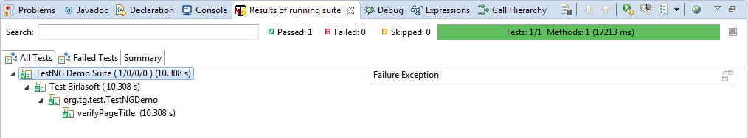
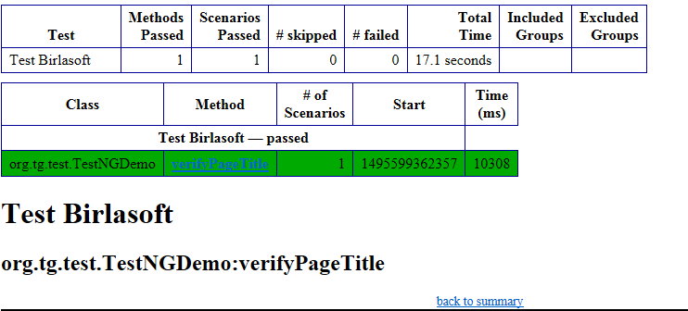
TestNG Reporting
TestNG Report
Produce the Test Report in Organized way
To view report click on ‘Result of TestNG’ tab
Display the total pass, fail and skipped test
Calculate time taken during execution
Three sub-tabs ‘All Tests’, ‘Failed’, ‘Summary’
TestNG – HTML Report
Create test-output folder
Create various HTML Report
Emailable-report
Index html report

Slide 26
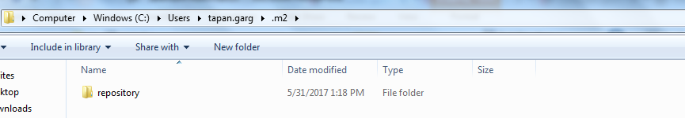
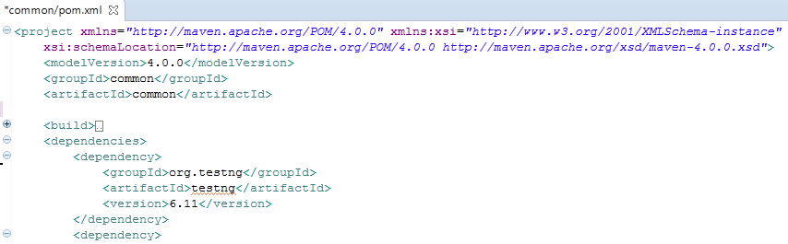
Maven
Software project management & Comprehension tool
Project build tool
Based on the concept of a project object model (POM), Maven can manage a project's build, reporting and documentation from a central piece of information.
Has its own repository where it keeps all plugin, jars etc. in commonplace called .m2 repository.
Create dependency using POM.xml
It download all dependent jar files automatically as defined.
Maven plugin comes by default for most of the Java iDE’s

Slide 27
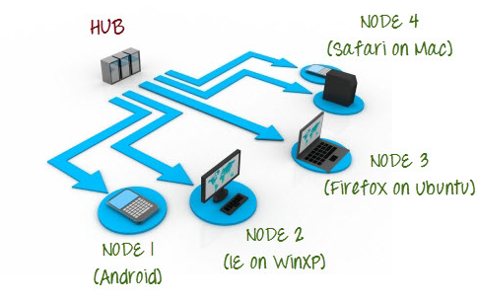
Selenium Grid
Selenium-Grid allows you run your tests on different machines against different browsers in parallel.
Uses a hub-node concept
Support distributed test execution
Used to speed up the execution
Support running tests against multiple runtime environments
Advantages:
Reduce total execution time
Increased Productivity

Slide 28
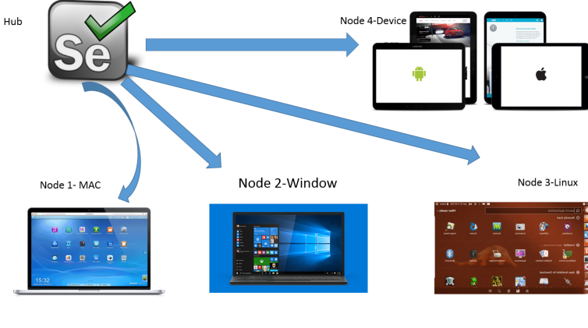
Hub and Node
Hub - It will redirect the commands to the respective node based on parameter.
Central point where you load your test.
One hub in a grid.
Distribute tests on different nodes.
Launched only on a single machine.
Node - Node will be the actual machine where the test will be executed.
Nodes are selenium instances that will execute the tests that you loaded on the hub.
One or more nodes in a grid.
Nodes can be launched on multiple machines with different platforms and browser.
The machines running the nodes need not be the same platform as that the hub.

Slide 29
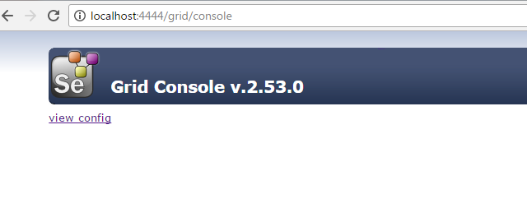
Hub Configuration
Requirements:
Selenium-Server standalone.jar
Java
Start the hub:
Open the command prompt and enter the below command
java –jar selenium-server-standalone-x.xx.x.jar –role hub
Once selenium hub is up and running you can check the status on the browser as well:
Open http://localhost:4444/grid/consoles and hit enter
Classification: Birlasoft Internal

Slide 30
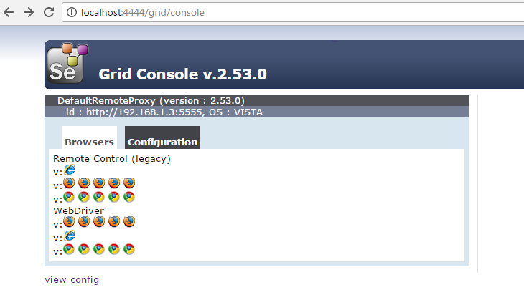
Node Configuration
Requirements:
Selenium-Server standalone.jar
Java
Start the node:
Open the command prompt and enter the below command
java –jar selenium-server-standalone-x.xx.x.jar –role node –hub http://localhost:4444/grid/register
Once node is ready to use you can check the status on the browser as well:
Refresh http://localhost:4444/grid/consoles
Classification: Birlasoft Internal

Slide 31
Hub Configuration using JSON
json file:
{
"port": 4444,
"newSessionWaitTimeout": -1,
"servlets" : [],
"withoutServlets": [],
"custom": {},
"capabilityMatcher": "org.openqa.grid.internal.utils.DefaultCapabilityMatcher",
"throwOnCapabilityNotPresent": true,
"cleanUpCycle": 5000,
"role": "hub",
"debug": false,
"browserTimeout": 0,
"timeout": 1800
}
Start Hub using command:
java -jar selenium-server-standalone-3.x.x.jar -role hub -hubConfig hubconfig.json
Classification: Birlasoft Internal

Slide 32
Node Configuration using JSON
Command: java -Dwebdriver.chrome.driver="chromedriver.exe" -Dwebdriver.ie.driver="IEDriverServer.exe" -Dwebdriver.gecko.driver="geckodriver.exe" -jar selenium-server-standalone-3.4.0.jar -role node -nodeConfig node1.json
json file:
{
"capabilities":
[
{
"browserName": "firefox",
"platform": "WINDOWS",
"maxInstances": 10
},
{
"browserName": "chrome",
"maxInstances": 1
},
{
"browserName": "internet explorer",
"maxInstances": 0
}
],
"configuration":
{
"proxy": "org.openqa.grid.selenium.proxy.DefaultRemoteProxy",
"maxSession": 5,
"port": 5555,
"register": true,
"registerCycle": 5000,
"hub": "http://localhost:4444",
"nodeStatusCheckTimeout": 5000,
"nodePolling": 5000,
"role": "node",
"unregisterIfStillDownAfter": 60000,
"downPollingLimit": 2,
"debug": false,
"servlets" : [],
"withoutServlets": [],
"custom": {} }
}
Classification: Birlasoft Internal

Slide 33
Selenium Grid - Demo
Requirements:
RemoteWebDriver to execute test on Grid Environment
DesiredCapability class to specify platform name and browser
import java.net.MalformedURLException;
import java.net.URL;
import org.openqa.selenium.*;
import org.openqa.selenium.remote.DesiredCapabilities;
import org.openqa.selenium.remote.RemoteWebDriver;
import org.testng.annotations.Test;
public class SeleniumGridTest {
@Test
public void runChrome() throws MalformedURLException {
// We have to mention browser which we want to use for test execution
DesiredCapabilities cap=DesiredCapabilities.chromeDriver();
// Set the platform where we want to run our test- we can use MAC and Linux and other platforms as well
cap.setPlatform(Platform.WINDOWS);
// Here you can use hub address, hub will take the responsibility to execute the test on respective node
URL url = new URL("http://localhost:4444/wd/hub");
// Create driver with hub address and capability
WebDriver driver = new RemoteWebDriver(url, cap);
// start application
driver.get("http://my.birlasoft.com/");
// get the title and print the same
System.out.println(“Birlasoft title is "+driver.getTitle());
driver.close();
}
}
Classification: Birlasoft Internal

